Slide 1
NEXTHIKES IT SOLUTION
PROJECT – 2
“Data Harmonization & Insights
Extraction”
MAHAK GOYAL

Slide 2
Introduction
“This project is all about to leverage advanced data- wrangling techniques
to produce a clean, unified dataset for future business analysis and
modeling.”
Visuals
“A well–integrated dataset prepared through systematic wrangling. Insightful
analysis ready for downstream applications.”

Slide 3
Why we use
Pandas: “Pandas is an essential library in Python for data analysis and manipulation. Its intuitive data structures (Series and DataFrame) and powerful features make it an indispensable tool for data science and machine learning tasks. With Pandas, handling and analyzing data becomes more efficient, enabling faster insights and better decision-making.”
NumPY:
“NumPY is highly optimized for performance and is the core library upon which many other scientific and data manipulation libraries (such as Pandas, SciPY, matplotlib, and scikit-learn) are built.”
“If you're working with numbers and large datasets in Python, you will almost certainly use NumPY.”

Slide 4
Key Features
1. Merging multiple dataset
Combining data from different sources into a single unified dataset.
Methods:
Concatenation: Stacking datasets on top of each other.
2. Resolving Discrepancies
Addressing inconsistencies within or between datasets to ensure data integrity.
Methods:
Data Duplication: Removing duplicate rows or entries based on a key.
Data Imputation: Filling missing values using statistical methods (e.g., mean, median, interpolation).
Data Validation: Cross-checking values against reliable sources or rules.
3. Standardizing Formats
Ensuring all datasets follow the same conventions and formats for consistency.
Methods:
Data Conversion: Converting units (e.g., from Celsius to Fahrenheit, or vice versa).

Slide 5
1. Data Inconsistencies
2. Varying units of measurement
4. Data Integrity and Quality Issues
5. Missing Data
3. Handling Duplicate Data
Challenges in ‘Data Harmonization’

Slide 6
1. Data Collection
5.Data Validation
Steps in Data Harmonization Process
4. Data Merging
2. Data Cleaning
3. Data Transformation

Slide 7
Insights Extraction from Harmonized Data
What is Insights Extraction?
Process of analyzing the harmonized data to uncover hidden trends and patterns.
It involves using analytical techniques like descriptive analysis, predictive modeling, and data visualization.
Methods:
Descriptive Analysis: Summarizing historical data.
Predictive Analytics: Forecasting future trends.
Data Visualization: Using graphs/charts to visualize insights.
Tools and Techniques
Data Visualization using tools like Python libraries (Matplotlib, Seaborn) to present insights effectively.

Slide 8
Insights Extraction Process
Step 1: Data Exploration
Step 4: Actionable Insights
Step 2: Data Analysis
Step 3: Visualization

Slide 9
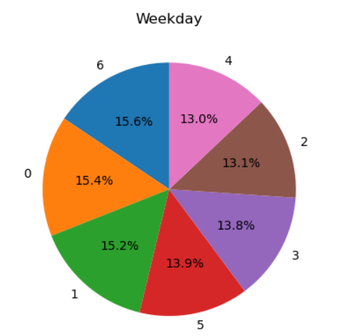
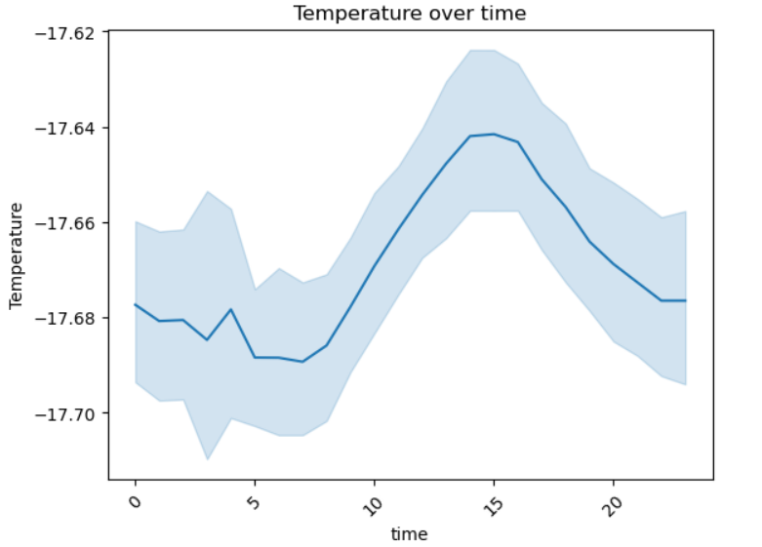
Visualizing Insights from Harmonized Data:
What is Data Visualization? Data visualization is the graphical representation of data and insights extracted from it. It uses charts, graphs, and other visual tools to make complex data easier to understand and interpret, facilitating informed decision-making.
PIE
Key Benefits of Visualizing Insights from Harmonized Data:
Clear Communication
Pattern Recognition
Enhanced Decision-Making
Increased Engagement

Slide 10
Types of Visualizations for Insights Extraction
1. Bar Charts 8. violin plots
2. Line Graphs 9. stack plots
3. Pie Charts 10. Stem plots
4. Scatter Plots 11. Strip plots
5. Heat Maps 12. ECDF plots
6. Histograms
7. Box Plots

Slide 11
Benefits of Data Harmonization & Insights Extraction
1.Improved Decision-Making: Reliable data leads to accurate decisions.
2. Increased Efficiency: Time saved by automating data integration.
3. Enhanced Predictive Modeling: More accurate forecasting due to consistent data.
4. Actionable Business Strategies: Data-driven insights lead to better business actions.
Outlier Detection and Capping
Why Detect Outliers?
1. Accuracy of Results:
Outliers can skew statistical measures such as mean, variance, and standard deviation, affecting the accuracy of analyses.
2. Data Integrity:
Identifying and handling outliers ensures that the dataset better represent
the underlying patterns and avoids misleading results.

Slide 12
Methods for Outlier Detection
1. Statistical Methods:
Z-Score: Outliers are detected if their Z-score (number of standard deviations from the mean) exceeds a threshold (commonly ±3).
IQR (Interquartile Range): Data points that fall outside 1.5 times the IQR above the third quartile or below the first quartile are considered outliers.
2. Visualization:
Box Plots
Scatter Plots
Capping of Outliers
Capping is the process of limiting extreme values to a certain threshold, reducing their influence on the dataset. Common methods for capping include:
1. Cap at Specific Percentiles:
For example, values below the 1st percentile or above the 99th percentile can be replaced by the nearest valid data points.
2. Replace with Statistical Measures:
Extreme values can be capped or replaced by the mean, median, or a value determined by a specific percentile.

Slide 13
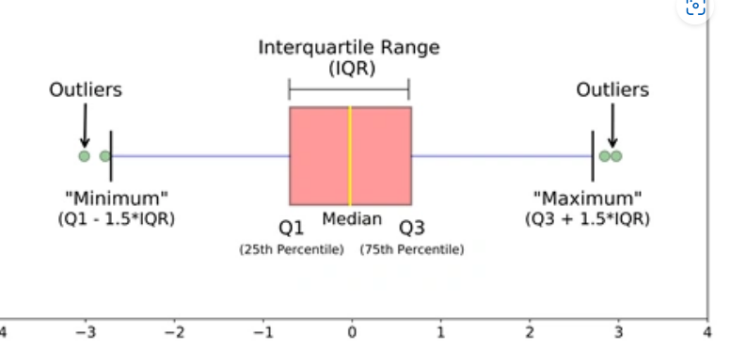
Benefits of Outlier Capping
1. Improved Model Performance:
Reduces the impact of extreme values, leading to more robust machine learning models.
2. Enhanced Data Quality:
Ensures the data used for analysis is consistent and representative of the majority of observations.
3. Better Decision Making:
Helps to focus on the meaningful patterns in the data, providing more reliable insights.

Slide 14
Reference:
https://www.analyticsvidhya.com/blog/2021/05/detecting-and-treating- outliers-treating-the-odd-one-out
https://www.geeksforgeeks.org/
https://seaborn.pydata.org/index.html
https://www.w3schools.com/
https://chatgpt.com
https://matplotlib.org/stable/plot_types/index.html

Slide 15
Thank You

